Slide 1
MODULE 5
An Autonomous Vehicle State Estimator

Slide 2
Module 5 | Putting It All Together
In this module…
Sensor fusion
Calibration
Sensor failures

Slide 3
MODULE 5 LESSON 1
STATE ESTIMATION IN PRACTICE
例えば、sensor fusion and calibration, speed and accuracy requirements, localization failures, parts of the environment that are moving and changing around us.

Slide 4
State Estimation with Multiple Sensors
Self-driving vehicles rely on data streams from many different sensors (cameras, IMUs, LIDAR, RADAR, GPS, etc.)
How can we combine information from all these sources?
We will discuss the sensor fusion problem in Lesson 2 and how we can use the EKF to do this

Slide 5
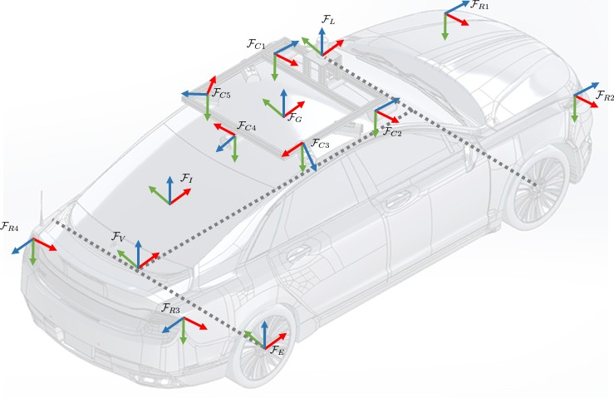
Calibration
What do we need to know about our sensors and the vehicle to do sensor fusion?
Sensor models, which may depend on car- specific parameters (e.g., wheel radius)
Relative poses between each sensor pair, so we can combine information in a common reference frame
Time offsets between sensor polling times, so we combine only synchronized information
These are all critical forms of calibration, which we will discuss in detail in Lesson 3

Slide 6


Accuracy Requirements
How accurate does the estimator need to be for safe self-driving?
Typically less than a meter for highway lane keeping
Less for driving in dense traffic
GPS accuracy is 1-5 meters in optimal conditions
Need additional sensors!
1.8 m
3.0 m

Slide 7
Speed Requirements
How fast do we need to update the vehicle state to ensure safe driving?
How much computation power does the vehicle have on-board?
How much power can our computing resources consume?
an update rate of 15Hz to 30Hz is a reasonable target for self-driving.

Slide 8
Localization Failures
How can localization fail?
Sensors fail or provide bad data (e.g., GPS in a tunnel)
Estimation error (e.g., linearization error in the EKF)
Large state uncertainty (e.g., relying on IMU for too long)
We will discuss strategies for coping with sensor failures in Lesson 4
GPS can have a difficult time coping with reflected signals in cities with a lot of tall buildings
The uncertainty in state grows as we propagate forward through the motion model and it only shrinks once we incorporate outside observations from LiDAR or GPS for example.

Slide 9
Our Dynamic World
Many of the models we use in practice for sensors like LIDAR, RADAR, cameras, etc. assume that the world is static and unchanging
In reality, the world is always moving and changing
We need to account for this in our models, or find ways of ignoring objects that don’t fit our assumptions
例えば、Lidar点群で自車運動量を予測する時や単眼カメラで自車運動量を予測する時だと思う。

Slide 10
Summary | State Estimation in Practice
Practical state estimation typically fuses data from multiple sensors
Calibration is important for correct sensor fusion
Estimation algorithms must be designed with speed and accuracy requirements in mind
Need to be able to cope with localization failures and environmental changes

Slide 11
MODULE 5 LESSON 2
MULTISENSOR FUSION FOR STATE ESTIMATION

Slide 12

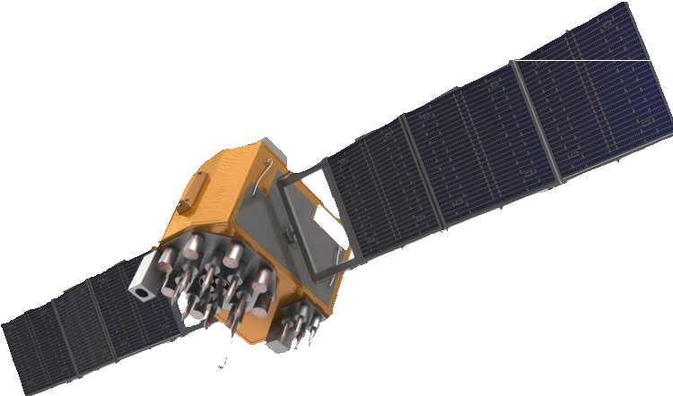
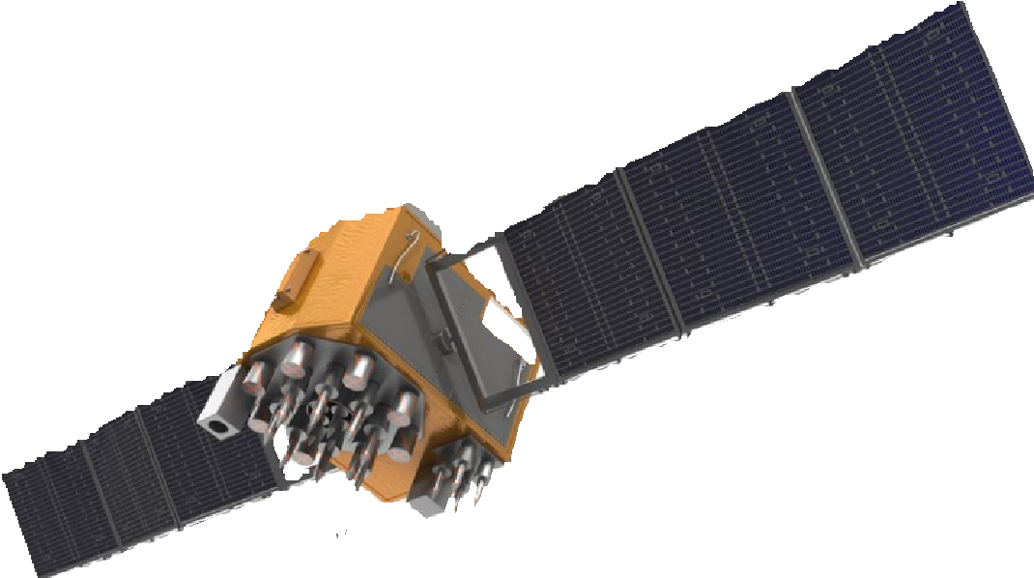
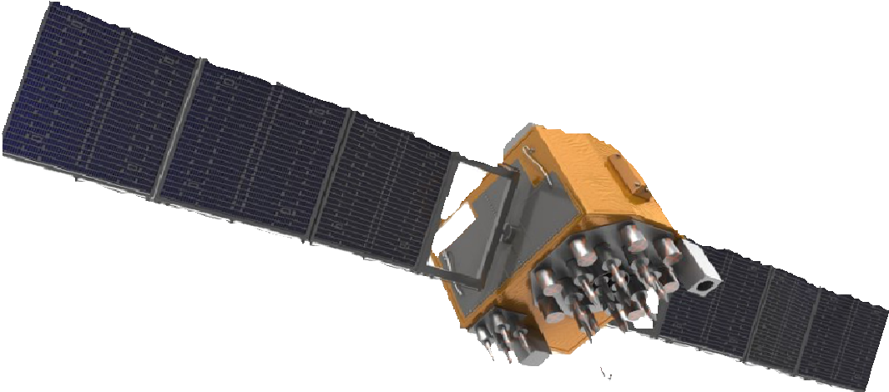











Multisensor Fusion for State Estimation
ℱ
s
ℱ
n
By the end of this video, you will be able to…
Develop an error state extended Kalman Filter for estimating position, velocity and orientation using an IMU, GNSS sensor, and LIDAR.

Slide 13
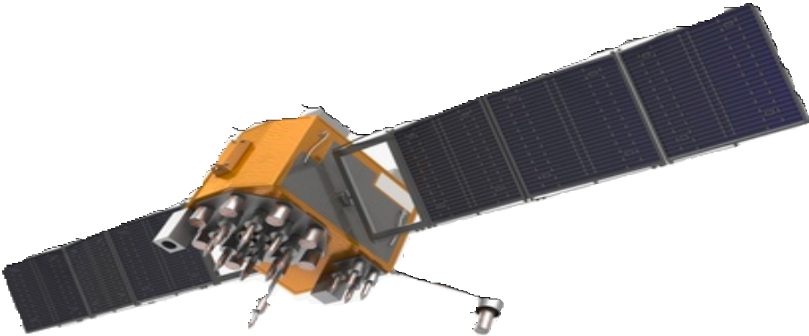
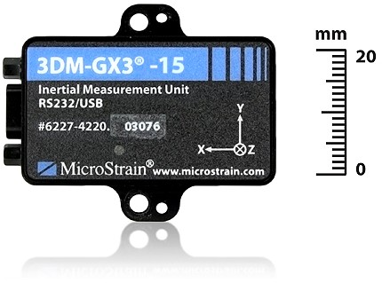
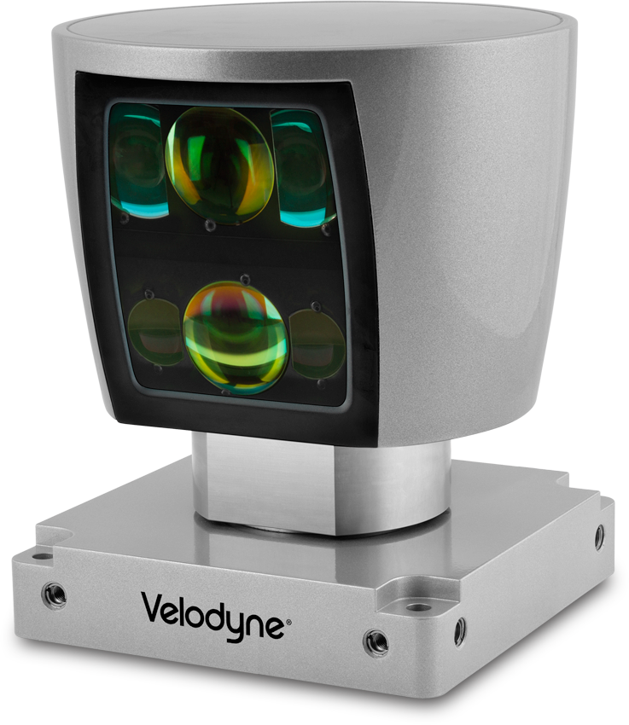
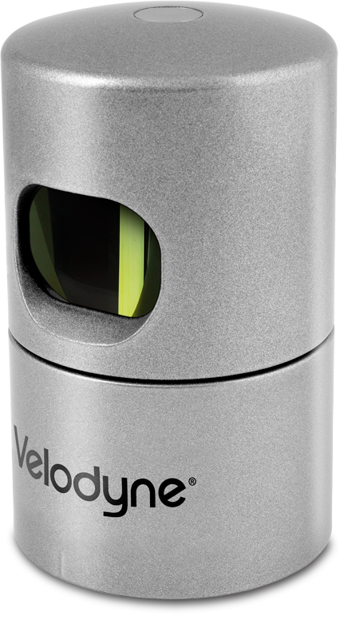
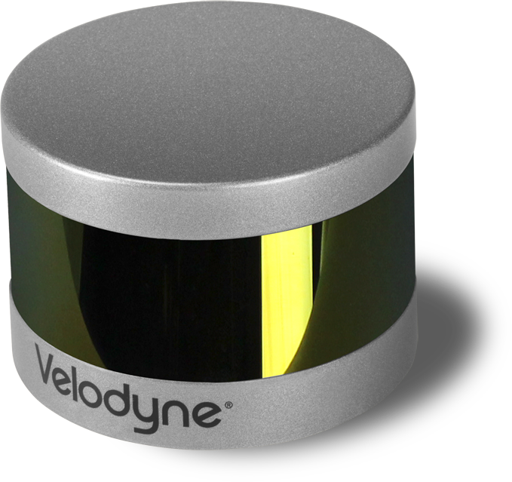
Why use GNSS with IMU & LIDAR?
Error dynamics are completely different and uncorrelated（無相関）
IMU provides ‘smoothing（平滑「へいかつ」化）’ of GNSS, fill-in during outages（供給停止） due to jamming（ジャミング、電波妨害） or maneuvering
Wheel odometry is also possible (if only 2D position orientation is desired)
GNSS provides absolute positioning information to mitigate IMU drift（ドリフト）
LIDAR provides accurate local positioning within known maps and in sky obstructed（遮られた「さえぎる」） locations.
Choose sensors that are complimentary(補足的) in nature.
correlatedの意味：if one fails, is the other likely to fail as well.
+
High-rate smoother
+
疑問：Known mapsは？
Known mapsはDetailed Road Mapや過去の運転で作ったOccupancy Grid MapやLocalization Mapかもしれないと思う。 Occupancy Grid MapやLocalization MapはLidar点群から（orカメラ）作ったんだ（C1M2 p55, 56）。
Conversely, GNSS can tell LiDAR which map to use when localizing.

Slide 14
Tightly versus Loosely Coupled
EKF Coupling
Tightly couple: tedious（退屈な） to implement and requires a lot of tuning.
Tight Loose
ゆるい
GNSS/LIDAR
Measurement
Pseudo-ranges to satellites LIDAR point clouds
Loosely coupled: assume the raw data have already been preprocessed to produce a noisy position estimate.
Position
(Potentially) Higher
(Potentially) Lower
Accuracy
Complexity
Higher
Lower
4

Slide 15
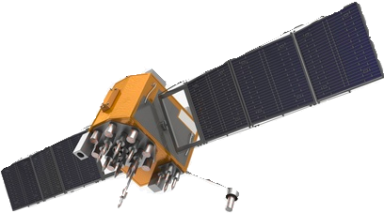
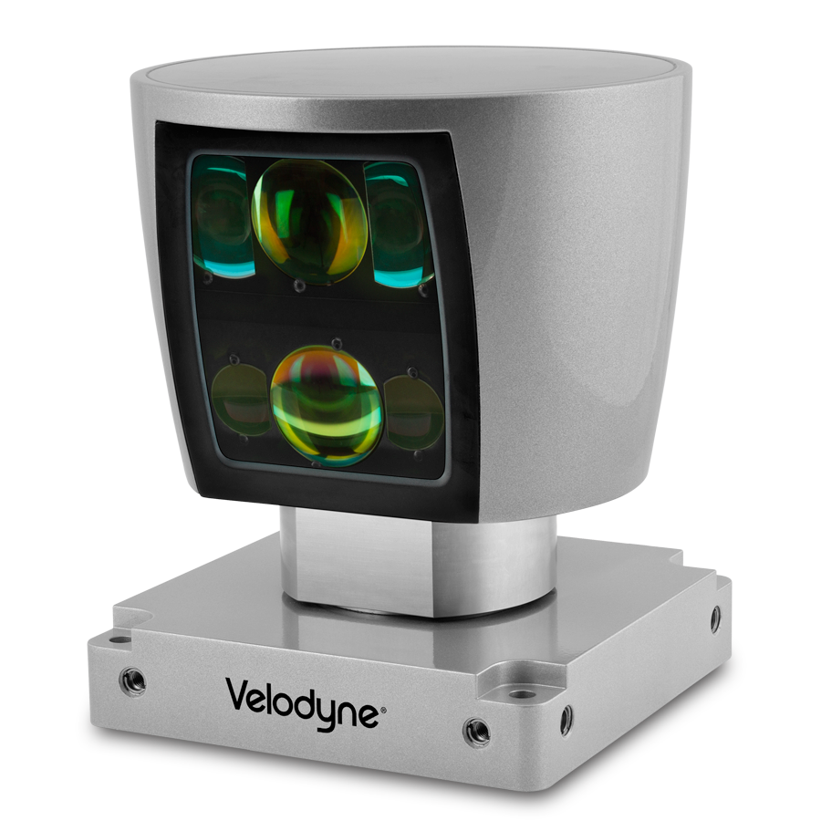
Extended Kalman Filter | IMU + GNSS + LIDAR
Motion Modelの更新はcan happen hundreds of times a second.
If GNSS/LIDAR available
IMU Only
Predicted
State xˇ_{k}
Corrected
State x̂_{k}
Motion Model
IMU
High rate
Position Observation
Kalman Fusion
GNSS
Low rate
LIDAR

Slide 16
Some Preliminaries（準備、前置き）
Vehicle state consists of position, velocity and parametrization of orientation using a unit quaternion:
p_{k}
v_{k}
_{∈ R}10
a 3D position, a 3D velocity, and a 4D unit quaternion representing the orientation of the vehicle with respect to a navigation frame.
x_{k} =
^{q}k
Motion model input will consist of specific force and rotational rates from our IMU:
復習：navigation frameはa frame that is fixed w.r.t. the ground. 2種類：NED frame & ENU frame.
f_{k}
[ω_{k}]
u_{k} =
∈ R⁶
From accelerometer and gyroscope measurements.
For clarity, assume IMU measurements are unbiased.

Slide 17

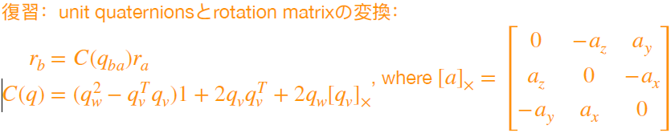
Motion Model
Sensor frameからnavigation frameへ回転
Δt
2
2
Navigation frameは初期フレームのことかもしれないと思う。もしくは、初期フレームがnavigation frameに対するオリエンテーショ。
Position
p = p + Δtv +
(
C f + g₎
k
k−1
k−1
ns k−1
Velocity
v_{k} = v_{k−1} + Δt ₍C_{ns}f_{k−1} + g₎
q_{k} = q_{k−1} ⊗ q(ω_{k−1}Δt) = Ω ₍q(ω_{k−1}Δt)₎ q_{k−1}
Orientation
keep track of the orientation of sensor frame w.r.t. the navigation frame. これはORB_SLAM2と同じだと思う。
the orientation change is measured in the local sensor frame.
where…
C = C (q )
_{sin} | θ |
q_{w}
₍[qv]₎
0 −q^{T}
[q −{q } ]
2
cos
Ω
= q 1 +
v
q(θ) =
| θ |
2
ns ns k−1
w
θ
| θ |
v
v ×

Slide 18
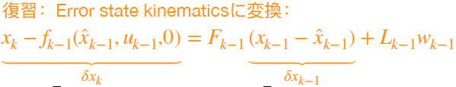

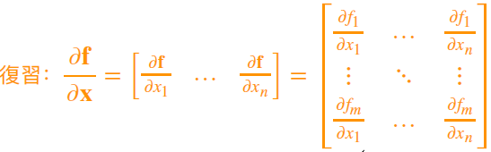
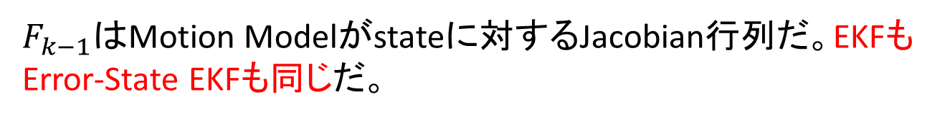
Linearized Motion Model
4次元Quaternionの差が3次元になるのは、global / navigationフレームの3軸に回る角度だ（オイラー角）と考えれば分かれると思う。オイラー角で表しているだけだと思う。 https://en.wikipedia.org/wiki/Conversion_between_quaternions_and_Euler_angles
Quaternionは常にglobal / navigationフレームでのオリエンテーションだから、その差もglobal / navigationフレームを参照するんだ。
Error State
Error Dynamics
^{δx}k ^{= F}k−1^{δx}k−1 ^{+ L}k−1^{n}k−1
δp_{k}
δx_{k} =
δv_{k}
∈ R⁹
There are some advantages to representing the orientation error in the global or navigation frame, rather than in the local frame.
δϕ_{k}
measurement noise
$F_{k−1}は$Motion Modelがstateに対するJacobian行列だ。EKFもError-State EKFも同じだ。
3x1 rotation error
赤い枠内の計算よくわかっていない。0は位置とオリエンテーションが独立していると意味していると思う。
where…
^{F}k−1 ⁼
0
0 1 −[C_{ns} f_{k−1}]×Δt
0 0 1
n_{k} ∼ 𝒩 ₍0, Q_{k)}
∼ 𝒩 0, Δt²
1 1Δt
0 0
1 0 0 1
L =
_{σ}2
k−1
[
acc
]
_{σ}2
gyro
1
is the 3 ×３
identity matrix
直感的に言うと、速度モデルが加速度計ノイズを含んでいる、Orientationモデルはgyroscopeノイズを含んでいる

Slide 19




Measurement Model | GNSS
y_{k} = h(x_{k}) + ν_{k}
= H_{k}x_{k} + ν_{k} = [1 0 0] x_{k} + ν_{k}
= p_{k} + ν_{k}
ν_{k} ∼ 𝒩(0, R_{GNSS})
use a very simple observation of the position, plus some additive Gaussian noise.
ℱ
n

Slide 20




Measurement Model | LIDAR
y_{k} = h(x_{k}) + ν_{k}
= H_{k}x_{k} + ν_{k} = [1 0 0] x_{k} + ν_{k}
= p_{k} + ν_{k}
ν_{k} ∼ 𝒩(0, R_{LIDAR})
ℱ
s
ℱ
n
Known map
We’ve assumed that LIDAR and GNSS will supply position measurements in the same coordinate frame.
In a realistic implementation, the GNSS position estimates may serve as a way to select a known map against which the LIDAR data can then be compared.
Occupancy Grid MapやLocalization Mapはオンラインで作ると思うので、過去の運転で作ったOccupancy Grid MapやLocalization Mapのことかもしれない。
疑問：known mapは？

Slide 21
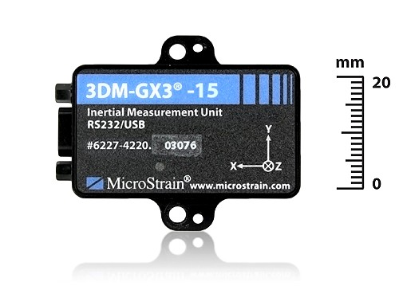

EKF | IMU + GNSS + LIDAR
Loop:
1. Update state with IMU inputs
Δt
2
2
^{pˇ}k ^{= p}k−1
+ Δtv +
(
C f + g ₎
pˇ_{k}
k−1
ns k−1
n
xˇ_{k} =
vˇ_{k}
vˇ_{k} = v_{k−1} + Δt ₍C_{ns}f_{k−1} + g_{n)}
qˇ_{k} = Ω ₍q(ω_{k−1}Δt)₎ q_{k−1}
^{qˇ}k
^{p}k−1^{, v}k−1^{, q}k−1
can be either be corrected or uncorrected depending on whether or not there was a GNSS/LIDAR measurement at time step k - 1
loop every time an IMU measurement occurs.

Slide 22
EKF | IMU + GNSS + LIDAR
Loop:
Update state with IMU inputs
Propagate uncertainty
^{Pˇ} k ^{= F}k−1^{P}k−1^{FT} 1 ^{+ L}k−1^{Q}k−1^{LT} 1
k− k−
Can either be
^{P̂}k−1 ^{or Pˇ} k−1
Accounting for whether or not the previous state was corrected or uncorrected.
At this point, if don’t have any GNSS or LIDAR measurements available, can repeat step one and two.

Slide 23
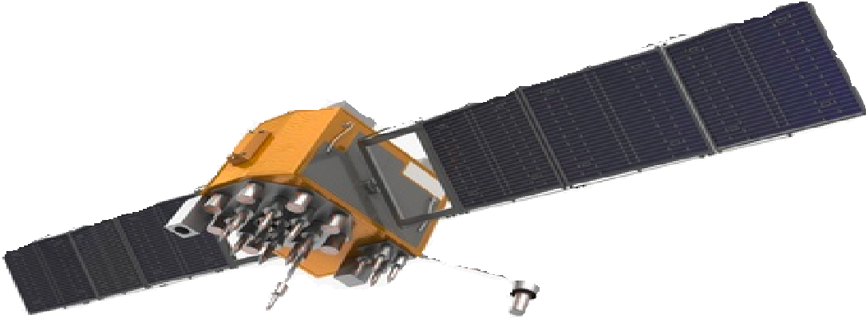
EKF | IMU + GNSS + LIDAR
Loop:
Update state with IMU inputs
Propagate uncertainty
If GNSS or LIDAR position available:
Compute Kalman gain
K_{k} = P^{ˇ} _{k}H^{T}(H_{k}P^{ˇ} _{k}H^{T} + R)⁻¹
k k
^{One of R}GNSS or ^{R}LIDAR

Slide 24
EKF | IMU + GNSS + LIDAR
Loop:
Update state with IMU inputs
Propagate uncertainty
If GNSS or LIDAR position available:
Compute Kalman Gain
Compute error state
δx_{k} = K_{k}(y_{k} − pˇ_{k})

Slide 25
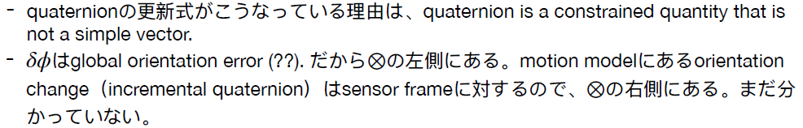
EKF | IMU + GNSS + LIDAR
Loop:
Update state with IMU inputs
Propagate uncertainty
If GNSS or LIDAR position available:
Compute Kalman Gain
Compute error state
Correct predicted state
p̂_{k} = pˇ_{k} + δp_{k}
v̂_{k} = vˇ_{k} + δv_{k}
q̂_{k} = q(δϕ) ⊗ qˇ_{k}
global orientation error

Slide 26
EKF | IMU + GNSS + LIDAR
Loop:
Update state with IMU inputs
Propagate uncertainty
If GNSS or LIDAR position available:
Compute Kalman Gain
Compute error state
Correct predicted state
Computed corrected covariance
P̂_{k} = (1 − K_{k}H_{k})P^{ˇ} _{k}

Slide 27




Summary | EKF for Vehicle State Estimation
We used a loosely coupled EKF to fuse GNSS with IMU and LIDAR measurements
Assumptions:
LIDAR provides positions in the same reference frame as GNSS (possible)
IMU has no biases (not realistic!)
State initialization is provided (realistic)
Our sensors are spatially and temporally aligned (somewhat realistic)
[2017] Quaternion kinematics for the error-state Kalman filter: https://arxiv.org/pdf/1711.02508.pdf
[2017] Advanced Vehicle State Estimation: A Tutorial and Comparative Study: https://www.sciencedirect.com/science/article/pii/S2405896317323674

Slide 28
MODULE 5 LESSON 3
SENSOR CALIBRATION: A NECESSARY EVIL

Slide 29








Calibration: A Necessary Evil
Intrinsic（内部） Calibration
Extrinsic(外部) Calibration
Temporal Calibration
v = ωR
ℱ
{C , r
LW
L
LW
W
}
Δt
ℱ
W
R
(single sensor)
deal with how the sensors are positioned and oriented on the vehicle.
deal with time offset between different sensor measurements.
deal with sensor specific parameters.
Another example of an intrinsic sensor parameter is the elevation angle of a scan line in a LiDAR sensor like the Velodyne.

Slide 30

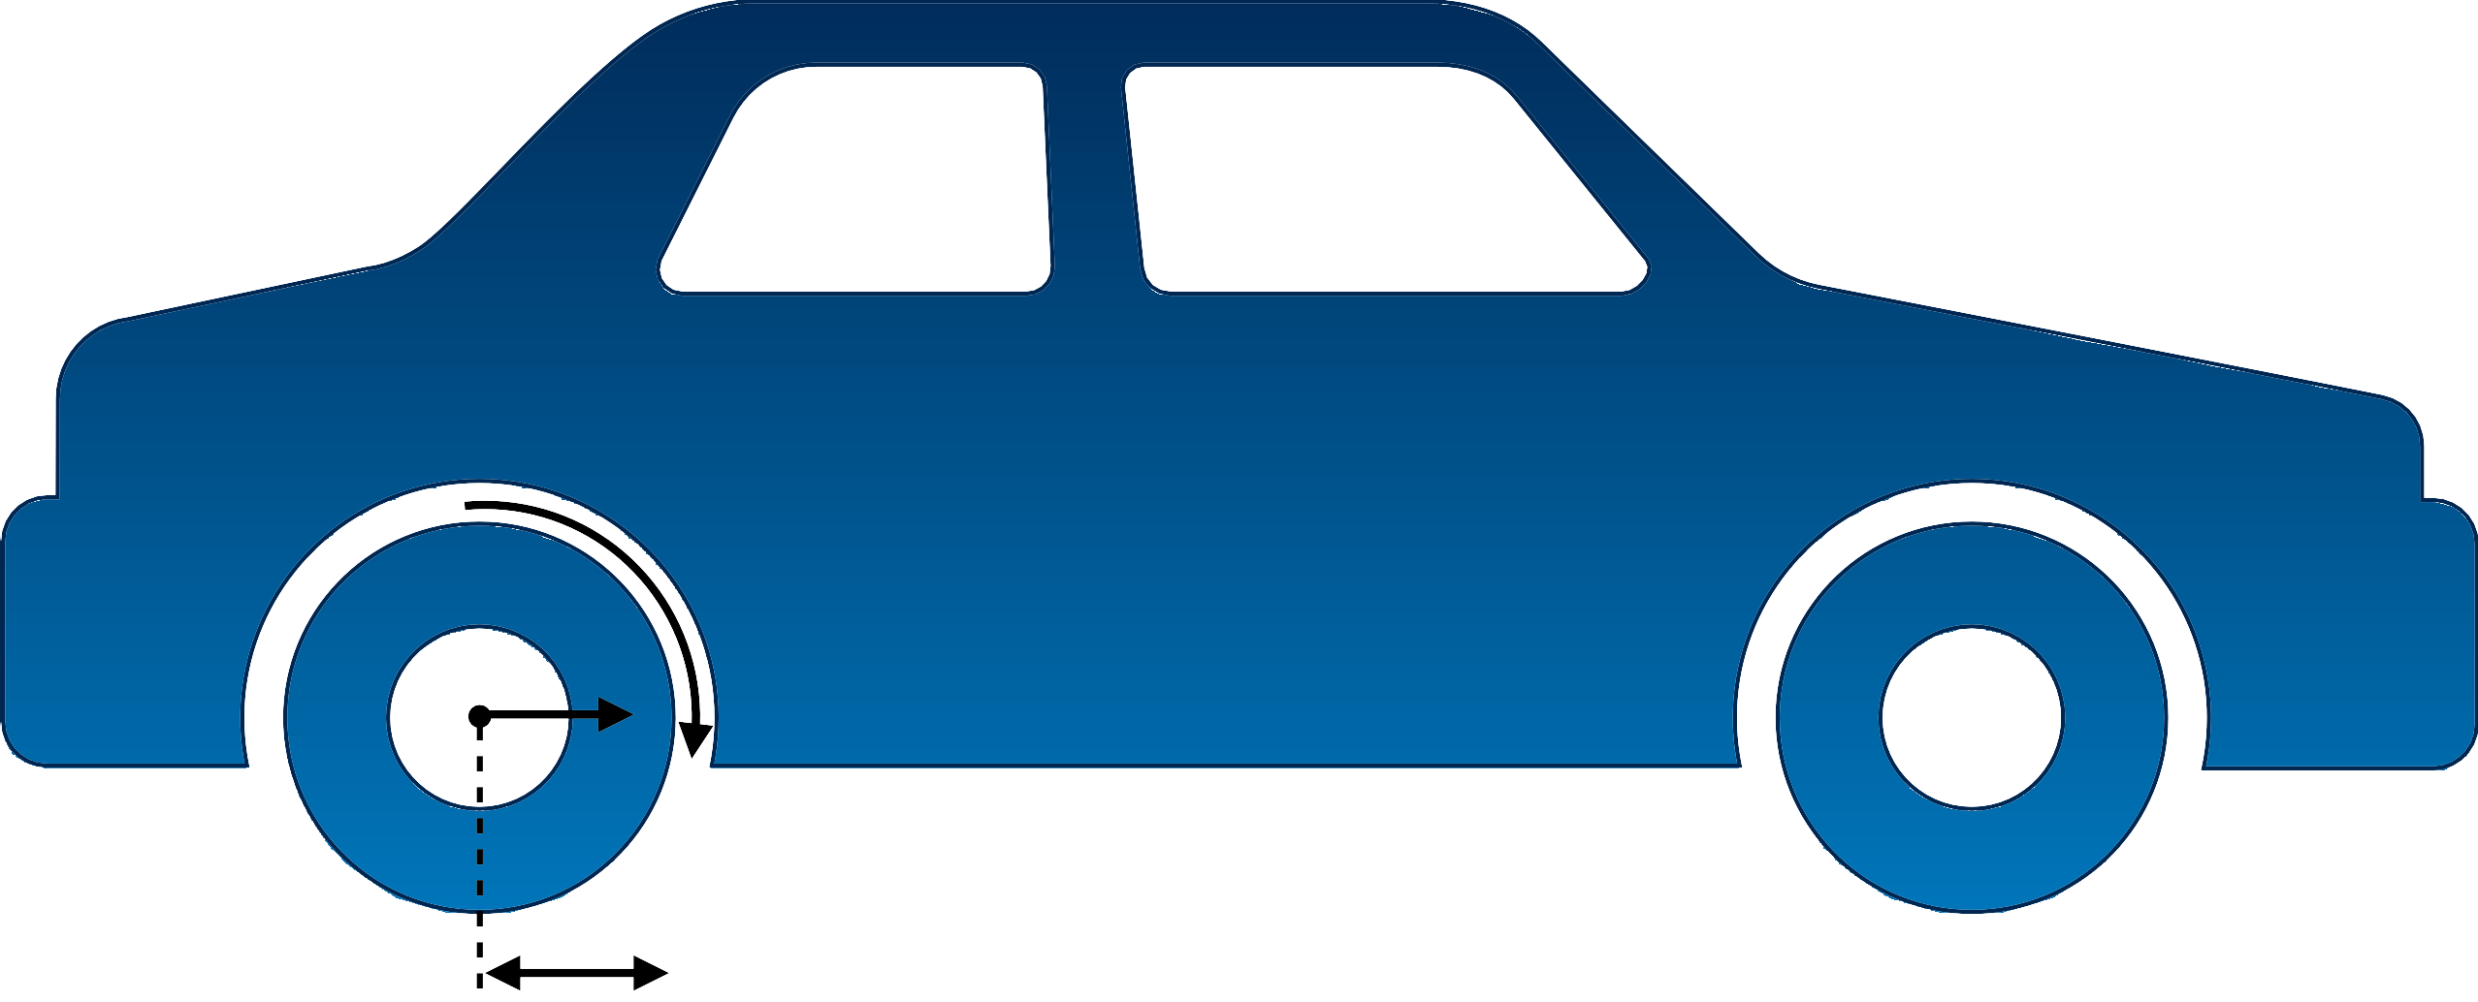

Intrinsic Sensor Calibration
How can we determine the parameters of our sensor models?
v = ωR
v
ω
R
Manufacturer specifications
Measure by hand
Estimate as part of the state
either on the fly or more commonly as a special calibration step before putting the sensors into operation.
メリット：this approach has the advantage of producing an accurate calibration that’s specific to the particular sensor and can also be formulated in a way that can handle the parameters varying slowly over time.
For example, if you continually estimate the radius of your tires, this could be a good way of detecting when you have a flat(パンクしたタイヤ).

Slide 31




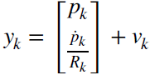
Calibration by Estimation
Motion Model
1 Δt 0
x
x =
[
]
+
0
u + w
k
0 1 0
k−1
[
]
k−1
k−1
Δt
v
0 0 1
0
自分が追加した
ω
w_{k} ∼ 𝒩(0, Q_{k})
R
Position, p
Position / Wheel Rate Observations
p _{p}·
R
u = p··
p· = v = ωR
x =
v_{k} ∼ 𝒩(0, R_{k})
Stateの中にタイヤの半径を入れている

Slide 32
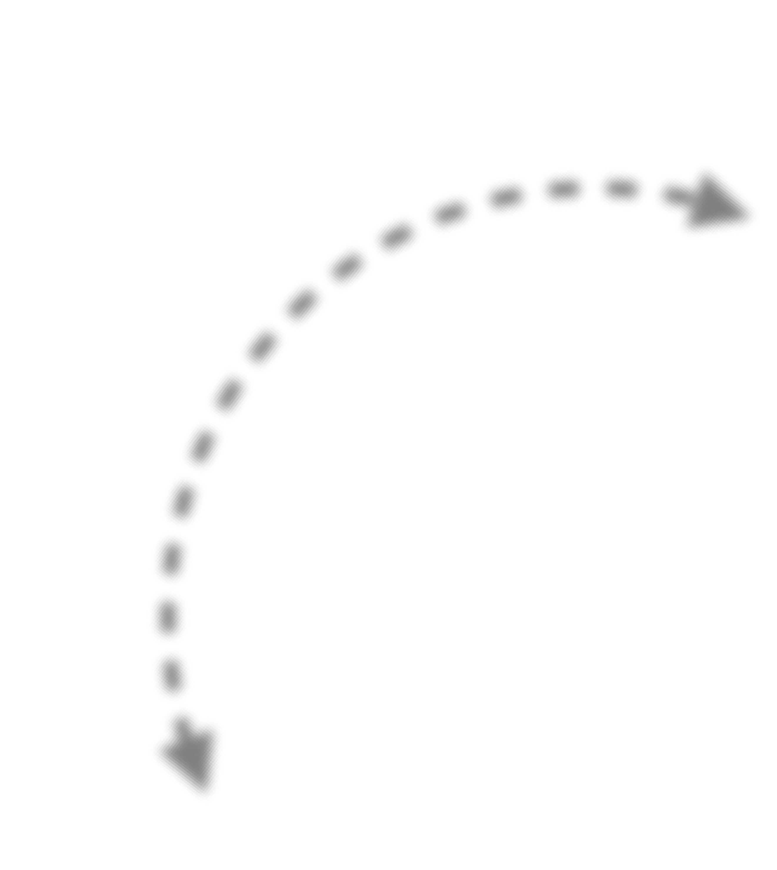

Extrinsic Sensor Calibration
Determine the relative poses of sensors usually with respect to the vehicle frame.
For example, the relative pose of IMU and LiDAR, so that the rates reported by the IMU are expressed in the same coordinate system as the LiDAR point clouds.
How do we determine the relative poses of all the sensors?
{
C , r
LI
}
LI
I
this is often difficult or impossible to do accurately since many sensors have the origin of their coordinate system inside the sensor itself.
CAD model
Measure by hand
Estimate as part of the state
all of the sensor frames have been nicely laid out.

Slide 33




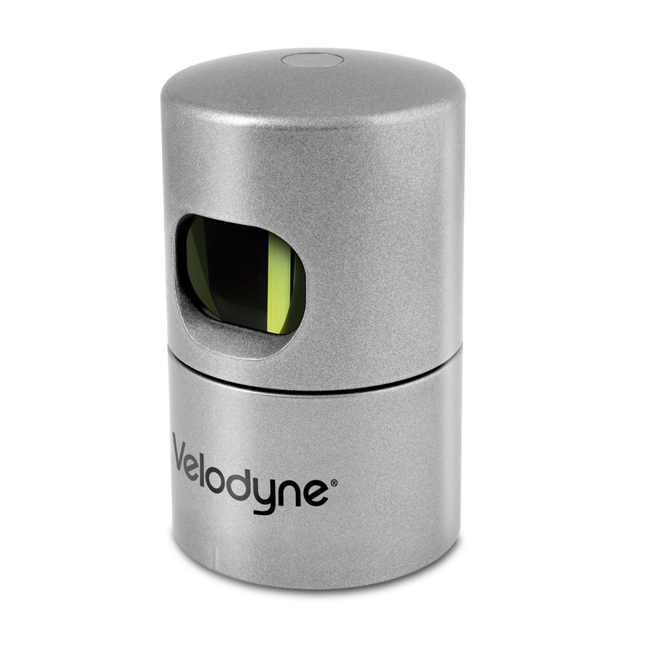
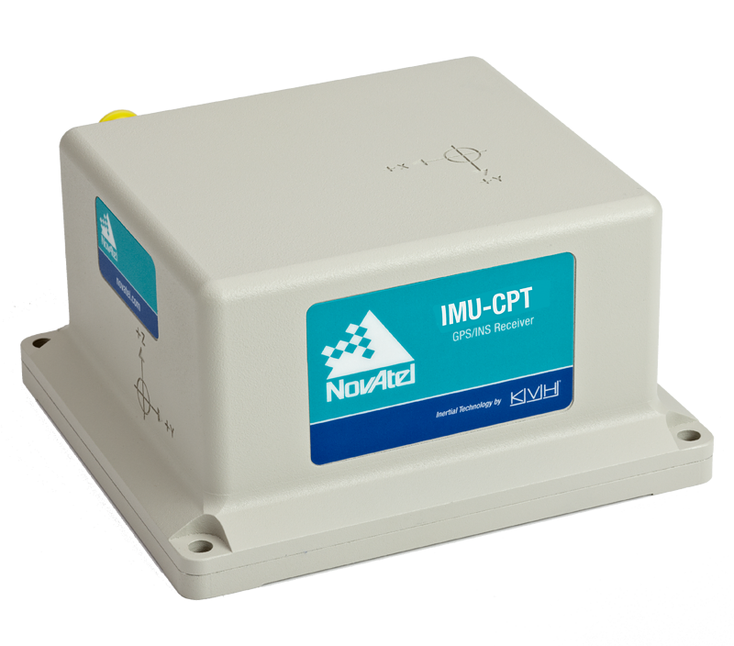




Temporal Calibration
For example, if we get LiDAR scans at 15Hz and IMU readings at 200Hz, might want to pair each LiDAR scan with the IMU reading whose timestamp is the closest match.
But in reality, there’s an unknown delay between when the LiDAR or IMU actually records an observation and when it arrives at the computer.
LIDAR clock System clock
IMU clock
^{Δt}L,S
^{Δt}I,S
use hardware timing signals to synchronize the sensors, but this is often an option only for more expensive sensor setups.
How do we determine the relative time delays of all the sensors?
Assume zero
Hardware synchronization
Estimate as part of the state
LIDAR clock, System clock, IMU clockが同期できたら、このtime delayは測れるが、同期できない場合は、データがSystemに到達する時間しか利用できないと思う。

Slide 34
MODULE 5 LESSON 4
LOSS OF ONE OR MORE SENSORS

Slide 35
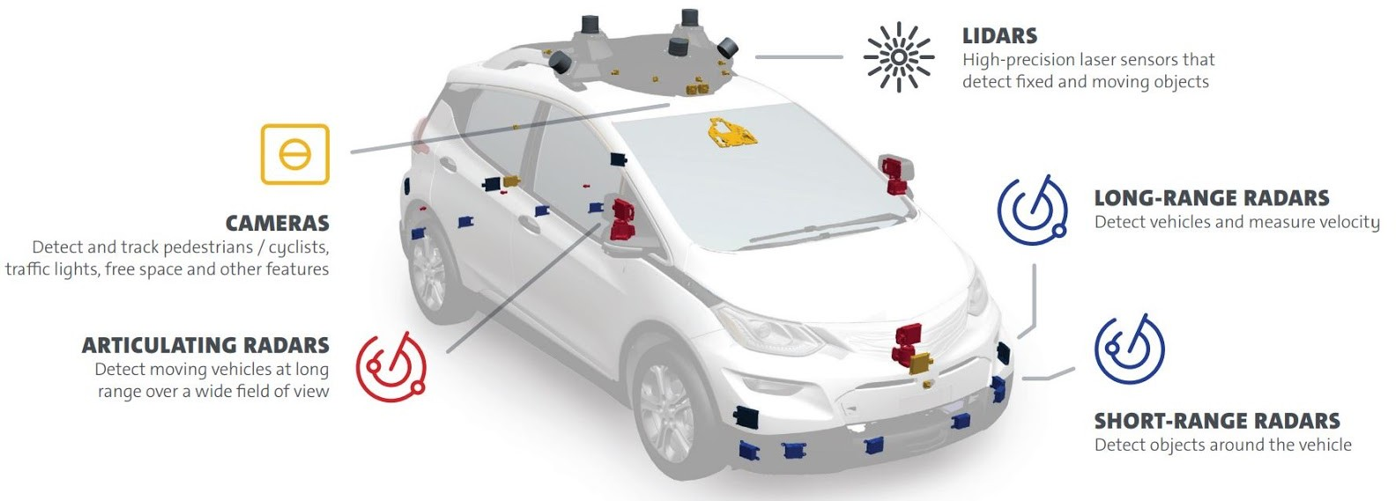
Multiple Sensors are Essential
Source: GM/Cruise Safety Report

Slide 36



Sensing Failures
ℱ
s
ℱ
n
GNSS and other external sensors can fail as a result of the environment, or weather.

Slide 37
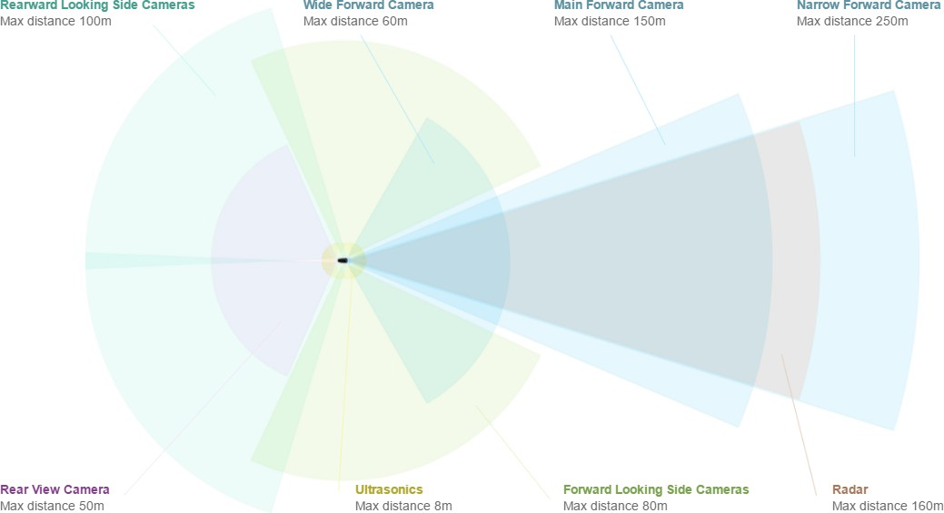
Sensors Measurement Ranges
2016 Tesla Model S Autopilot Sensors
Most cars have long, medium, and short range sensing.
short range sensors for parking and to ensure not to collide with nearby vehicles.
medium range sensors help in pedestrian and cyclist detection and in lane keeping.
long range sensors help detect and predict the motion of approaching distant obstacles.
If one of these fails, have to ensure that the safety of the car occupants or the people around us is not compromised. （センサーが失敗する場合、周りの車や人に傷つけないように）
Source: electrek.co

Slide 38
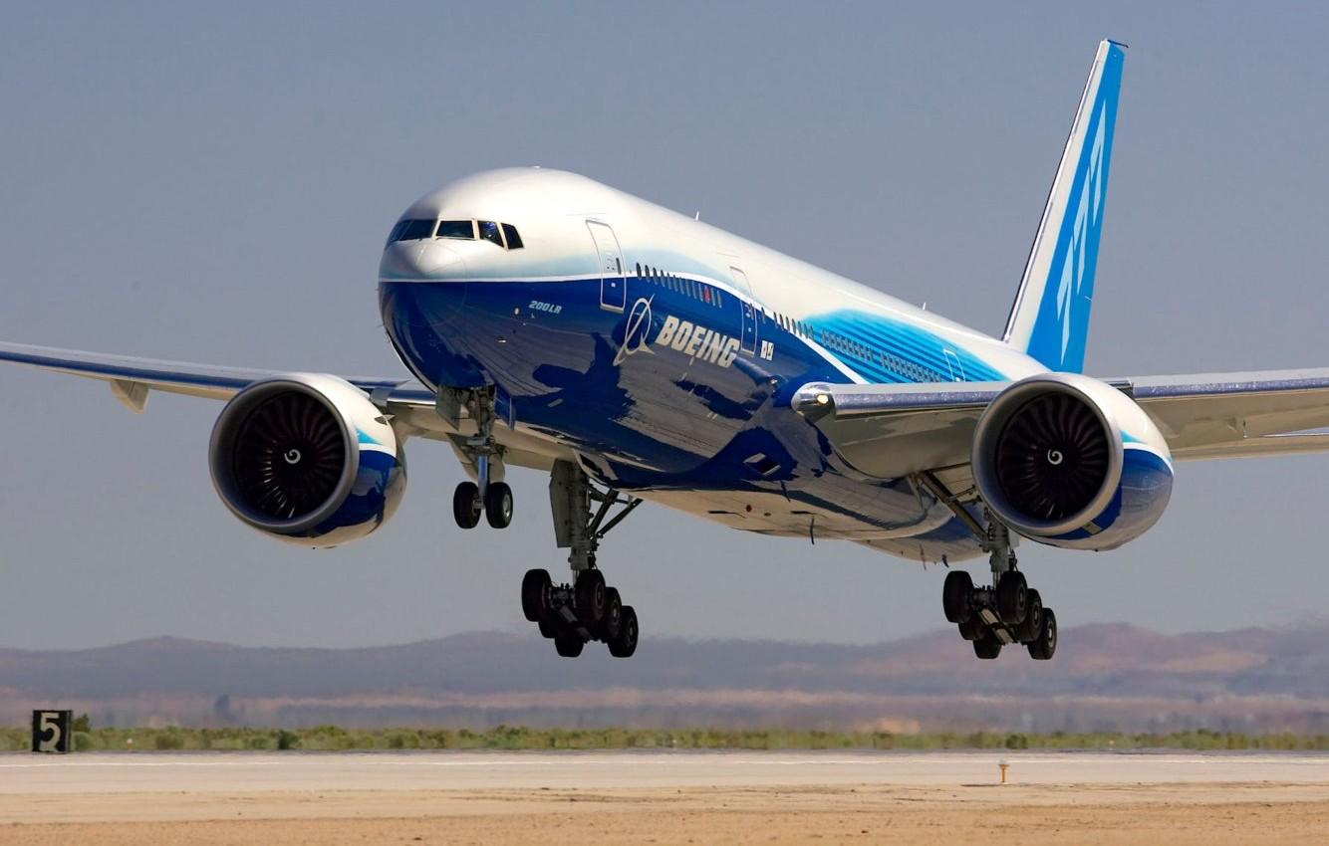
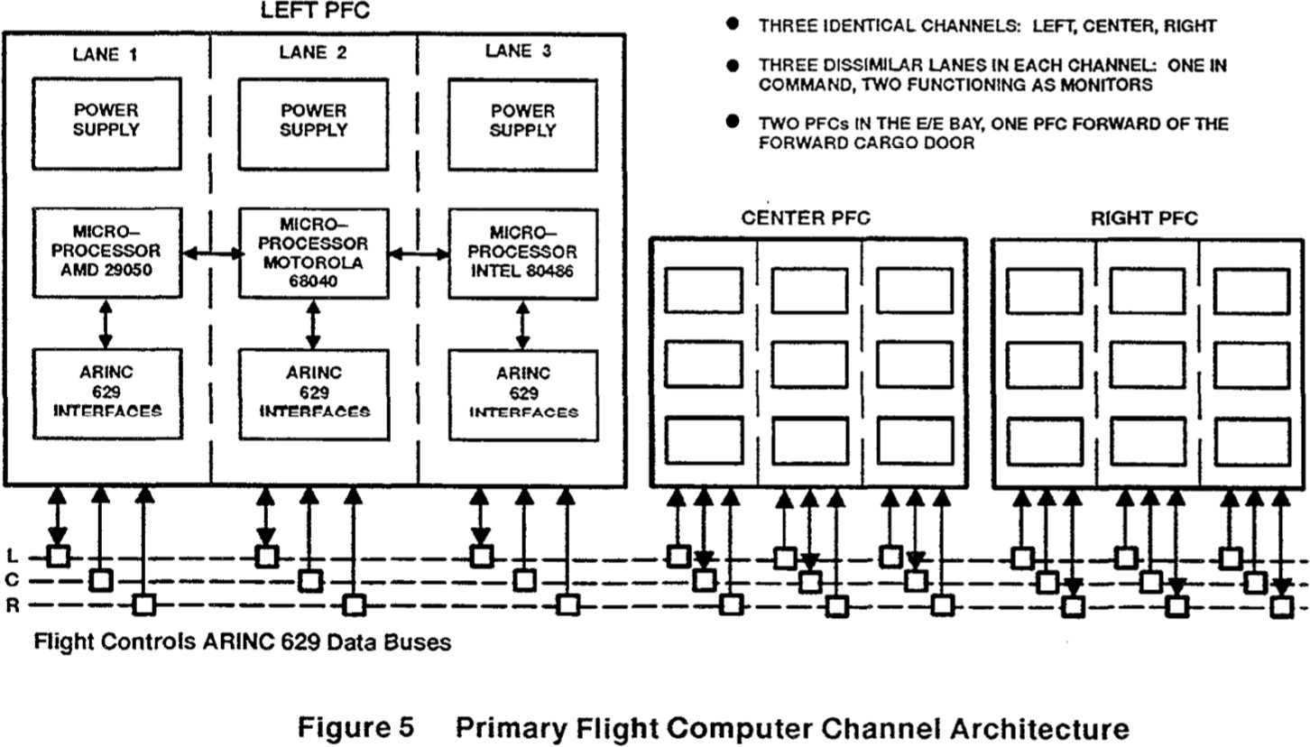
Redundant Systems: 777 PFC
The 777 operates on a triple redundancy（冗長「じょうちょう」化） principle.
All major systems, including the flight computer, have two backups, each with independent power and separate programming and specifications.
separate programmingはちょっとすごい。同じバグを防げるのは分かっているが。どう⾔う意味？下の説明によると、hardwareのみseparateされるらしい。つまりsoftwareは同じ？で はsoftwareのバグが発⽣したら、ヤバイ。多分これはそもそも許されないこと。
Each of the flight computers has a different processor to ensure that a bug in the architecture itself doesn’t affect all three computers.
例えばprocessorはそれぞれmicro-processor AMD 29050, MOTOROLA(モトローラ) 68040, INTEL(インテル) 80486.
If one of the computers fails or malfunctions, the 777 uses a consensus（コンセンサス、合意） algorithm to seamlessly（継ぎ目なく） switch to another one.

Slide 39
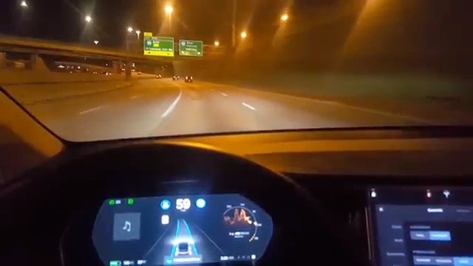
Redundancy is Crucial | Lane keeping
https://www.youtube.com/watch?v=6QCF8tVqM3I

